Slide 1
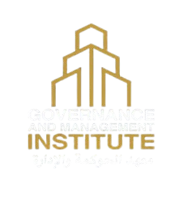
GMI
Digital Marketing Project
DEPI DIPLOMA PRESENTATION

Slide 2
Agenda
Business Brief
Business Model CANVAS
Situation Analysis (SWAT & Competitor)
Objectives (SMART Goals)
Business Strategy (STP)
Tactics (The 4Ps)
7. Actions (Implementation Plan)
8. Implementation: A New Visual Identity
9. Implementation: Content Strategy
10. Analysis: SEO Audit & Key Findings
11. Challenges & Control
12. Recommendations & Improvements

Slide 3

Client: Governance & Management Institute (GMI), led by Dr. Mohamed Mostafa.
Core Service: High-level professional training, certifications, and consultations in Governance, Management, and Compliance.
Business
Brief
Project Goal: Develop a comprehensive digital strategy to enhance GMI's visual identity, unify its online presence, and generate qualified leads.
Target Audience: Government Officials, Corporate Managers/Executives, and Ambitious Young Professionals.

Slide 4









International Accreditation Bodies (Academy of Leeds, UK).
Expert Trainers and Consultants.
Delivering professional training and diplomas.
Providing expert consultation services.
Marketing and Lead Generation.
Research & Development of new programs.
Operations management (registration, testing, certification)
Conducting research and disseminating knowledge
Internationally and locally accredited professional certifications
Flexibility in delivery (online and in-person).
expert instructors.
Comprehensive consulting services
Direct support and consultation.
After-training support.
Building a professional community.
Individuals:
New Graduates, Mid-Level Managers, and Executive Leaders.
Institutions:
Government Entities, Private Sector Companies, and Banks/Financial Institutions.
KEY PARTNERS
KEY ACTIVITIES
VALUE PROPOSITIONS
CUSTOMER RELATIONSHIP
CUSTOMER
SEGMENTS
Website (gfbalex.com)
Social Media (Facebook, LinkedIn)
Direct Contact (WhatsApp)
Direct Partnerships
Webinars and workshops
Expert instructors (led by Dr. Mostafa).
Accredited course materials.
GMI Brand & Reputation.
Digital Platforms.
CHANNELS
KEY
RESOURCES
BUSINESS MODEL CANVAS
Marketing & Advertising Costs.
Instructors & Staff Salaries.
Accreditations and licenses.
Platform & Website Maintenance.
Training Programs & Diplomas.
Professional Certifications
Consultation Services.
Corporate Internship Contracts
COST STRUCTURE
REVENUE STREAM

Slide 5
SITUATION ANALYSIS
SWOT
Strengths
S
Strong specialization in Governance.
Expert trainers & international accreditation (Academy of Leeds).
Direct client communication (e.g., WhatsApp).
Weakness
W
Inconsistent visual identity
Low social media engagement
Under-promoted consultation services
Opportunity
O
Growing demand in MENA region
Untapped LinkedIn potential
Online program expansion
Threats
T
Strong competition with larger budgets.
reducing training budgets.
Competitive AI Learning Preference

Slide 6
SITUATION ANALYSIS
Competitors
Account | Followers | Strengths | Key Weaknesses
GMI (Our Client) | 1.3K | • Strong Specialization (Governance, Management, Risk) • Accredited Certificates (International/Local) | • Very low engagement • Inconsistent posting • Not promoting consultations
مركز المديرين المصري (EIOD) | 13K | • Official credibility • Clear course announcements | • Poor public responsiveness to comments/inquiries. • outdated/non-working contact websites (EIOD)
National Training Academy (NTA) | 206K | • Huge following • Presidential support • High credibility • Professional designs | • Moderate engagement (0.12%) • Minimal comment responses
Report here

Slide 7



Our Business Strategy
(STP)
Segmentation
Targeting
Positioning
Individuals:
New Graduates, Mid-Level
Managers, and Executive Leaders.
Institutions:
Government Entities, Private Sector Companies, and Banks/Financial Institutions.
Our primary focus is on Corporate professionals and ambitious Individuals, as they are most active online and have immediate training needs.
Platform Focus: LinkedIn ,Facebook , and Google (search intent)
Governance & Management Institute is a leading MENA institution specializing in corporate governance, risk management, and compliance. We deliver internationally accredited certificates and expert consultancy services to develop leaders and enhance governance practices according to global standards.

Slide 8

Buyer
Persona
Goals
How We Reach Him
Build a strong foundation in governance and management principles
Obtain accredited certifications to increase employability
Develop practical skills valued by major corporations
Stand out in competitive job markets
Social media content highlighting career advancement
Special offers and payment plans for young professionals
Success stories from similar career starters
Content focused on practical application of governance principles
Frustrations
Key Message
Name:
Ahmed
Age:
25 years
Limited practical experience
High competition for quality positions
Budget constraints for professional development
Difficulty identifying valuable training programs
"Launch your career with confidence through internationally accredited training from GMI."
Education:
Bachelor's degree in business
Languages:
Arabic & English fluent
Digital Presence:
Instagram, Tiktok, occasionally Facebook

Slide 9

Buyer
Persona
Goals
How We Reach Him
Advance to senior leadership positions
Develop strategic leadership and governance expertise
Enhance team performance through better management practices
Distinguish herself from peers with specialized certifications
Professional content on governance best practices
Case studies showing career advancement results
Flexible learning options (online weekend/evening sessions)
Testimonials from similar professionals who advanced their careers
Frustrations
Key Message
Name:
Dalia
Age:
35 years
Career stagnation in current role
Limited time for professional development
High cost of quality executive education
Balancing work responsibilities with learning
"Transform your leadership capabilities and position yourself for the next level with GMI's expert-led programs."
Occupation:
HR Manager
Sector:
private organization
Digital Presence:
Facebook, and LinkedIn

Slide 10

Buyer
Persona
Organizational Goals
How We Reach Him
Develop team expertise in governance, risk management and compliance
Ensure organizational adherence to international standards
Implement effective governance frameworks
Solve specific administrative challenges through expert consultation
LinkedIn thought leadership content
Industry-specific white papers and case studies
Direct consultation offers addressing specific governance challenges
Frustrations
Key Message
Name:
Emad
Age:
40 years
Need to justify training budgets to board/stakeholders
Resistance to change within organization
Finding partners with both academic expertise and practical experience
Implementing governance structures in complex environments
"Effective governance transforms your organization's performance and positions you as an industry leader.“
"GMI: Your strategic partner in building transparent, high-performing institutions through expert training and consultation."
Occupation:
Executive in Corporation
Industry:
Corporate
Digital Presence:
LinkedIn, industry conferences, direct consultations

Slide 11

Objectives
(SMART Goals)
Launch and maintain a consistent content calendar with 3 professional posts per week across Facebook and LinkedIn to position GMI as a thought leader in governance and management.
Grow Facebook followers by 50% within 3 months through consistent, professional content and strategic engagement.
Increase Brand Awareness
Establish Authority
Generate Qualified Leads
Transform Website into Educational Platform
Achieve 15 new lead inquiries per month via digital channels by optimizing content and implementing effective call-to-actions.
Convert gfbalex.com into a comprehensive governance educational platform by publishing 8 original blog articles monthly on governance topics.

Slide 12
Marketing Tactics:
Place (Distribution):
The 4Ps
Physical: GMI's office in Cairo for consultations
Website (gfbalex.com)
Social Media : Facebook, LinkedIn, Tiktok, and YouTube
Price
Promotion
Competitive and accessible pricing, reflecting value without a premium cost
Social Media Marketing: Consistent content highlighting course benefits and limited-time offers
Special Course Offers: Strategic discount packages for early enrollment, group registrations, and alumni
SEO: Optimizing the website to be found on Google
Product:
High-value professional diplomas.
Specialized certificate courses.
Expert consultation services.

Slide 13
Our 3-Phase
Action Plan
Phase 3: Audit & Recommendation
Conducted a comprehensive SEO audit of (gfbalex.com)
Developed final recommendations.
Analyzing campaign performance data.
Phase 2: Implementation & Engagement
Post consistently on Facebook.
Engage with the audience.
Launching targeted paid campaigns
Phase 1: Rebranding
New visual identity development (color palette, templates) to build trust.
Created a 1-month social media content calendar.

Slide 14
Control: Measuring Success
(KPIs & Tools)
Key Performance Indicators (KPIs)
Follower Growth Rate
Engagement Rate (Likes, Comments, Shares)
Click-Through Rate (CTR) on Links
Number of Lead Inquiries
Measurement Tools
Platform | Key Metric to Measure | Tool Used for Analysis
Facebook | Engagement and CTR (Click-Through Rate) on posts. | Facebook Insights (Native Analytics)
LinkedIn | Impression share and connection growth. | LinkedIn Analytics (Native Analytics)
Website (SEO) | Organic Traffic & Keyword Ranking Position. | Google Analytics & Google Search Console Screaming frog, SEMrush

Slide 15
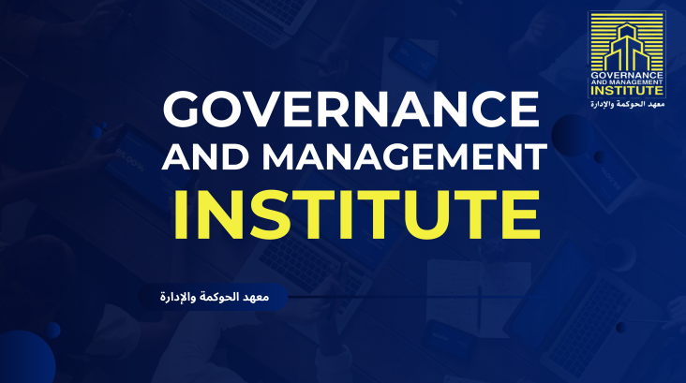
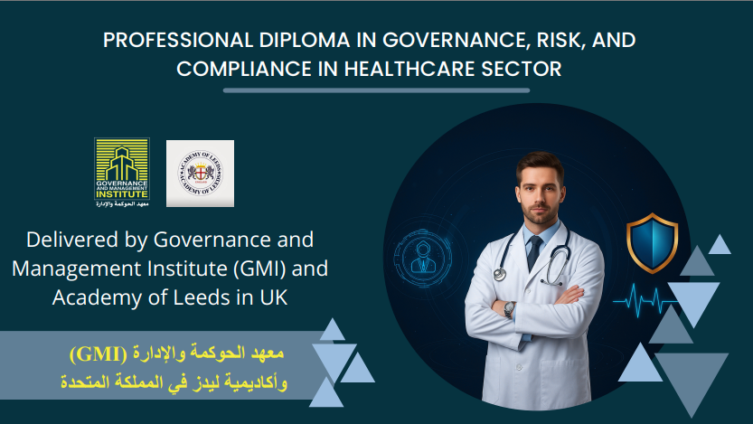
Implementation:
A New Visual Identity
BEFORE (Old Identity)
AFTER (Our New Identity)
Outdated, generic design
Modern, professional, and trustworthy
Clashing colors (yellow & blue)
Sophisticated, calm color palette (dark teal/blue)
Low-trust aesthetic
High-trust, corporate aesthetic
Tools Used: Canva
Full PDF (Before, After)

Slide 16
Implementation:
Content Strategy
Content Pillars
Content that explains governance, risk, compliance, internal audit, and corporate leadership concepts — helping position GMI as a trusted authority.
Posts focused on promoting GMI’s professional certificates, diplomas, and online/offline programs with clear value propositions.
Content showcasing GMI’s consulting offerings for governance, internal control, family businesses, compliance systems, and board performance evaluation.
Highlighting achievements from previous trainees, real transformation stories, measurable improvements, and before/after results to build trust and credibility.
Program Promotion
Consultation Services
Educational
Success Stories
Four Strategic Content Pillars Enhancing GMI's Digital Presence
Social Media Calendar

Slide 17
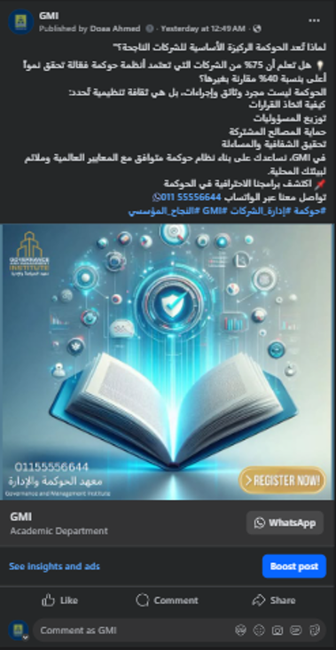
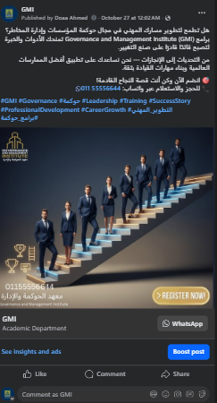
Implementation:
Content Strategy

Slide 18
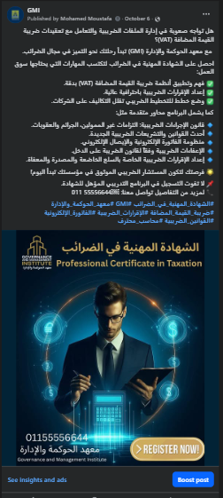
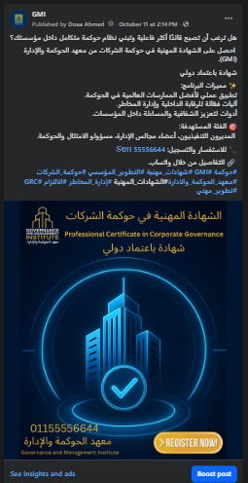
Implementation:
Content Strategy

Slide 19

Implementation:
Content Strategy
Tools Used:
app.pictory.ai/
ezremove.ai
aistudio.google.com/

Slide 20
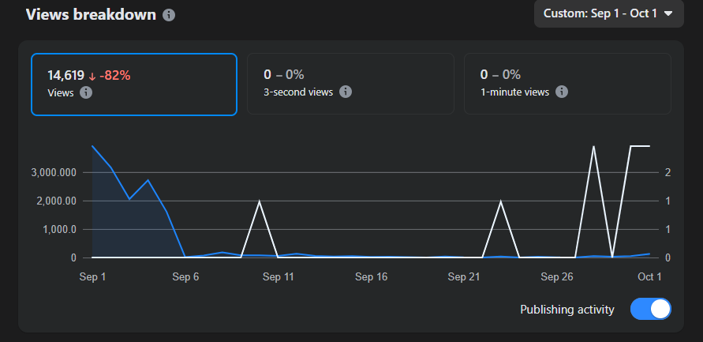
Analysis:
Facebook Performance

Slide 21
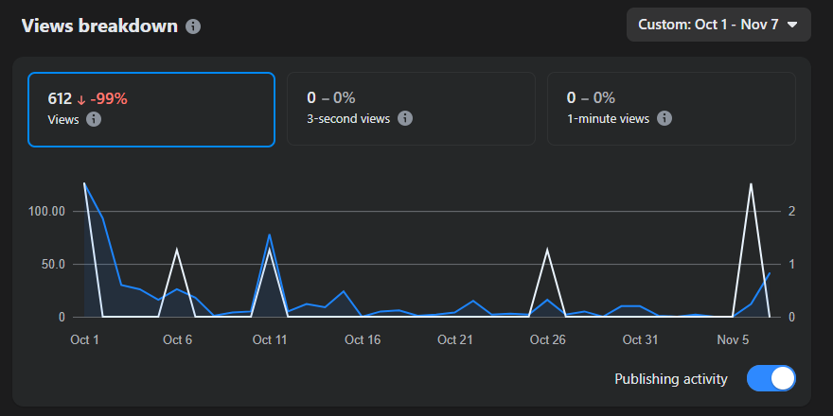
Analysis:
Facebook Performance

Slide 22

Analysis:
SEO Audit for gfbalex.com
Critical Issues:
❌ No meta descriptions
❌ Lack of Content & Structure: No blog to capture search traffic.
❌ Poor heading structure (H1/H2).
❌ No XML sitemap
❌ Slow loading speed (34/100 PageSpeed score)
❌ Lack of relevant Keywords
Technical Strengths:
✅ Mobile-friendly design (confirmed via Lighthouse)
✅ Secure HTTPS connection
✅ No broken internal links detected
Full Report Here

Slide 23
Recommendations
& Future Improvements
Based on our analysis, we have three key recommendations for GMI to achieve digital success:
Implement the SEO Audit
Launch a Google SEM Campaign
Launch Email Marketing
Create Authentic Video Content:
Feature Dr. Mostafa in videos to build trust and authority,
moving beyond AI-generated content.

Slide 24
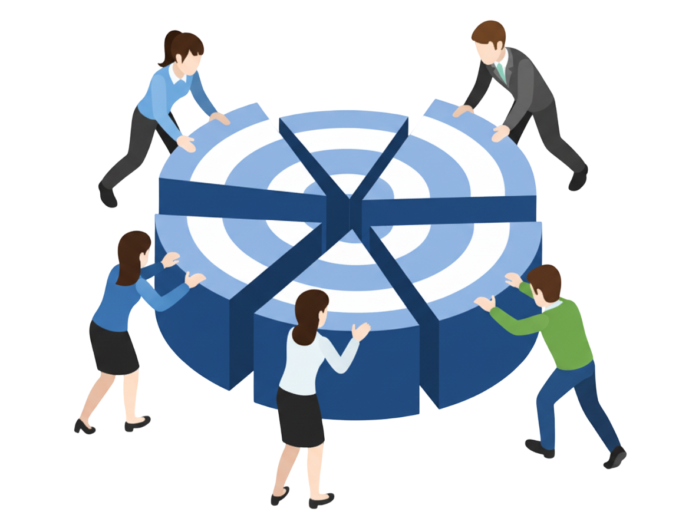
OUR
TEAM
Doaa Ahmed
Abanob Samir
Maha Mohamed
Ahmed Omar
Amira Rashed

Slide 25
Thank
You!

